Slide 1
How a University Campus Comes to Life Through the Lens of Environmental Data
Gianni Tumedei <gianni.tumedei2@unibo.it>
Manuele Pasini <manuele.Pasini@unibo.it>

Slide 2
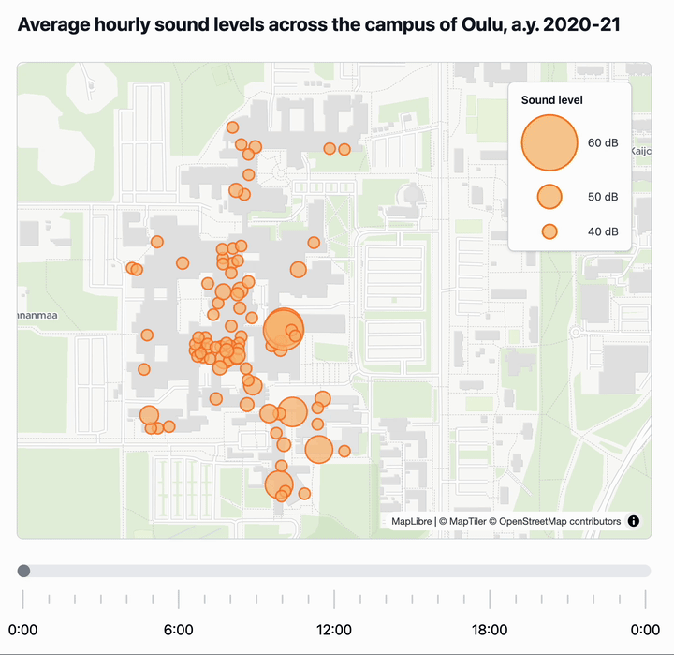
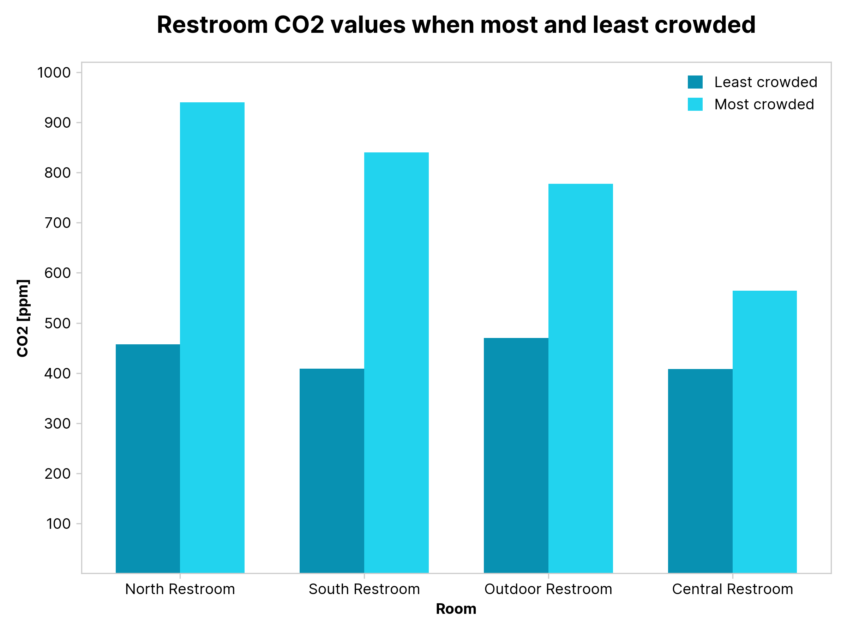
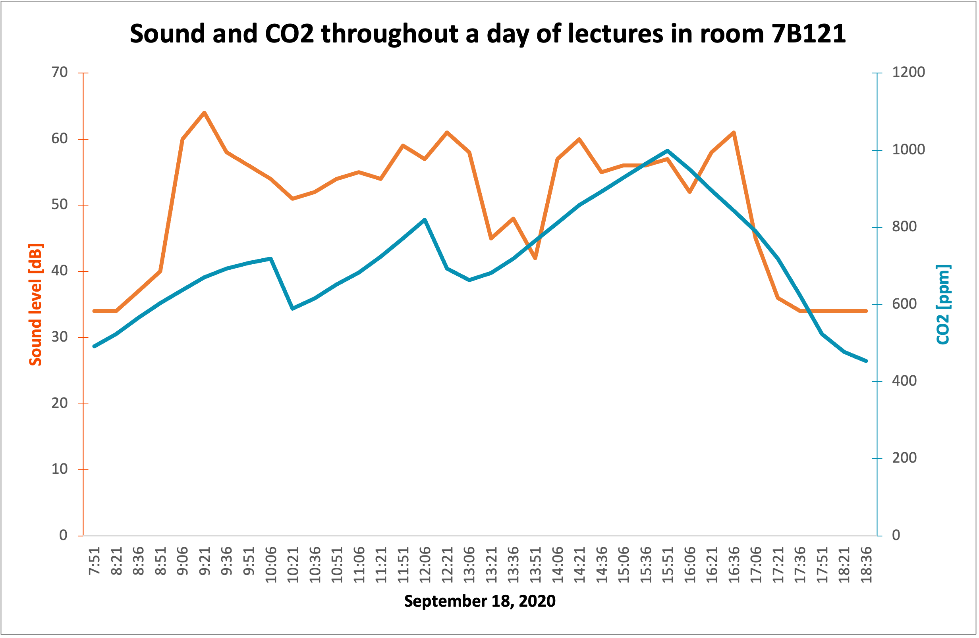
Overview

Slide 3
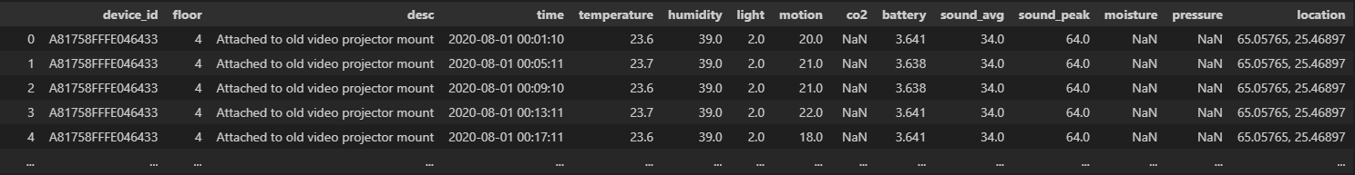
Dataset
Dataset link: https://ieee-dataport.org/documents/smart-campus-dataset
Time-series of measurements of IoT devices within the Smart Campus of Oulu, in Finland
429 distinct devices
~ 90M measurements from 2020-08-01 to 2021-02-23
One row for each device measurement
15 attributes
4 categorical attributes
11 numerical attributes

Slide 4
Visualization 1
In this visualization, we tried to represent the flow of people going through the campus throughout the day.
Given the spatial dimension, we opted for a bubble map.
We tried to only keep measurements from days where the campus was open and frequented (i.e. we filtered out weekends and holidays).
We aggregated by sensor and hour of the day, then used the coordinates of each sensor to plot the bubbles on the map.
In the TypeScript version, we added a slider to make the visualization interactive.

Slide 5
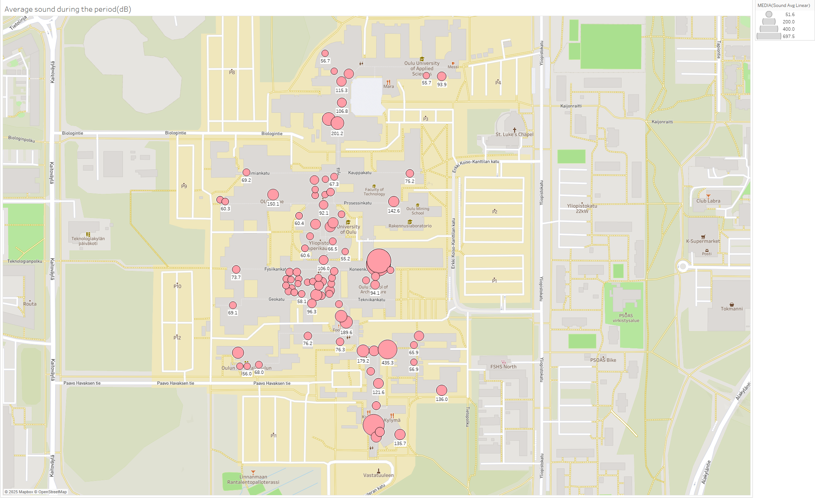
Visualization 1
Tableau version
TypeScript version (D3, Maplibre GL)

Slide 6
Visualization 2
In the second visualization, we highlighted how the number of occupants in a room affects the CO2 levels.
In particular, we considered four restrooms and, for each room, we plotted the average CO2 values when the room is the least vs the most crowded.
We used a monochromatic color scheme, as all values on the chart are about CO2, and applied different shades to the min and max values.
We used a bar chart for clarity, ease of comparison, and good distinction among the four categories (rooms).

Slide 7
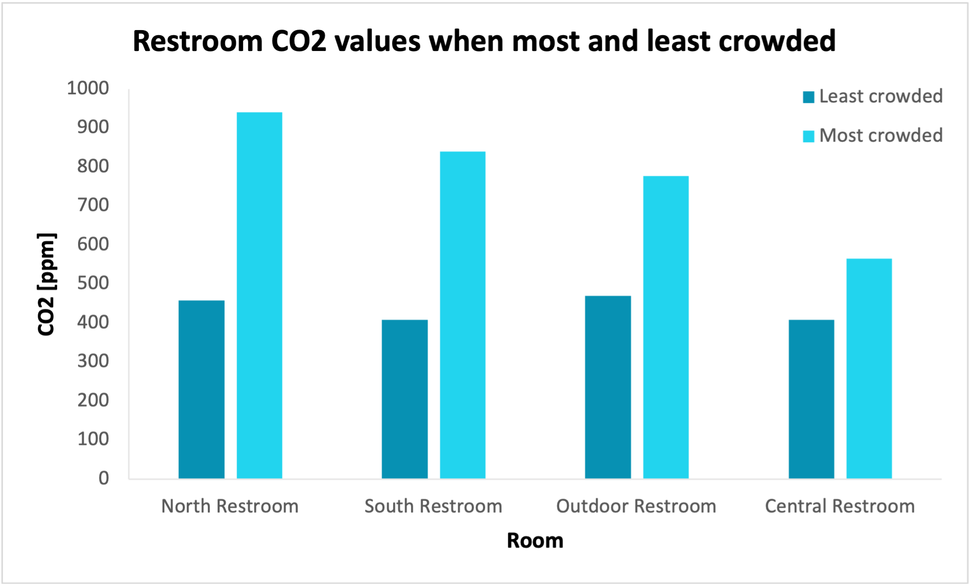
Visualization 2
Excel version
Python version (Matplotlib)

Slide 8
Deceptive/with error viz
Visualization
Motivation/Explanation
Here, we wanted to highlight a strong correlation between the sound and CO2 levels in a given classroom.
However, while CO2 levels are on a linear scale (ppm), sound values (dB) are logarithmic.
64 dB is the max sound level in this chart. It's about 1000x more intense than the min of 34 dB and 8x louder to the human ear.
This comparison between sound and CO2 should be taken with a grain of salt.

